Slide 1
Chapter 4.3 Defensive Programming
CCSW 325 (Software Construction)
Notes:
Last Update: 22/8/2019
Version 1.0

Slide 2
Outline
Defensive Programming (Part 3 of 3)
Exceptions
Determining How Much Defensive Programming to Leave in Production Code

Slide 3
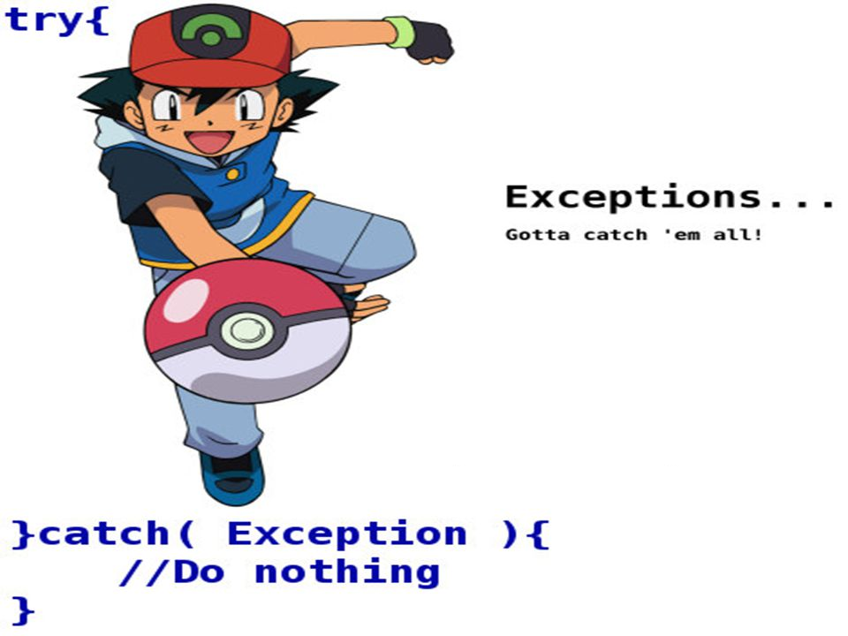
Exceptions

Slide 4
Exceptions
An exception is an event, which occurs during the execution of a program, that disrupts the normal flow of the program's instructions.
If code in one routine encounters an unexpected condition that it doesn’t know how to handle, it throws an exception, essentially throwing up its hands and yelling, “I don’t know what to do about this—I sure hope somebody else knows how to handle it!”
Code that has no sense of the context of an error can return control to other parts of the system that might have a better ability to interpret the error and do something useful about it.

Slide 5
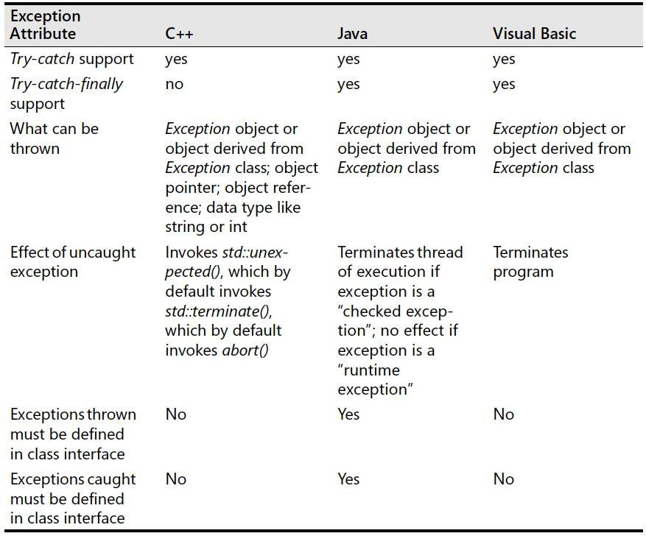
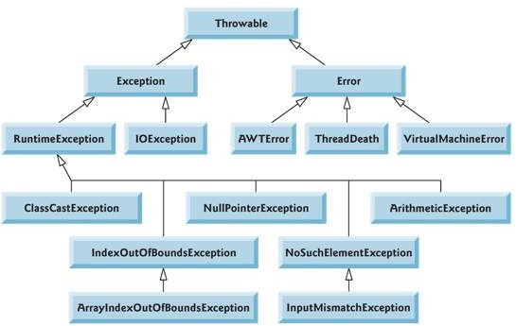
Exceptions
Popular-Language Support for Exceptions

Slide 6
Exceptions
Use exceptions to notify other parts of the program about errors that should not be ignored
The benefit of exceptions is their ability to signal error conditions in such a way that they cannot be ignored (Meyers 1996)
Other approaches to handling errors create the possibility that an error condition can propagate through a code base undetected. Exceptions eliminate that possibility.

Slide 7
Exceptions
Throw an exception only for conditions that are truly exceptional
Exceptions should be reserved for conditions that are truly exceptional—in other words, for conditions that cannot be addressed by other coding practices
Exceptions represent a tradeoff between a powerful way to handle unexpected conditions on the one hand and increased complexity on the other.

Slide 8
Exceptions
Don’t use an exception to pass the buck
If an error condition can be handled locally, handle it locally. Don’t throw an uncaught exception in a section of code if you can handle the error locally.
Avoid throwing exceptions in constructors and destructors unless you catch them in the same place
The rules for how exceptions are processed become very complicated very quickly when exceptions are thrown in constructors and destructors.

Slide 9
Exceptions
Include in the exception message all information that led to the exception
Be sure the message contains the information needed to understand why the exception was thrown.
If the exception was thrown because of an array index error, be sure the exception message includes the upper and lower array limits and the value of the illegal index.

Slide 10
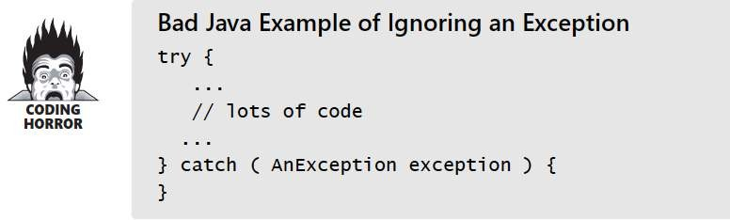
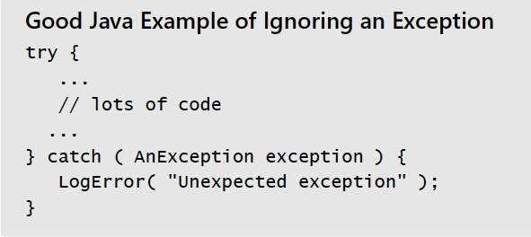
Exceptions
Avoid empty catch blocks
Either the code within the try block is wrong because it raises an exception for no reason, or the code within the catch block is wrong because it doesn’t handle a valid exception.

Slide 11
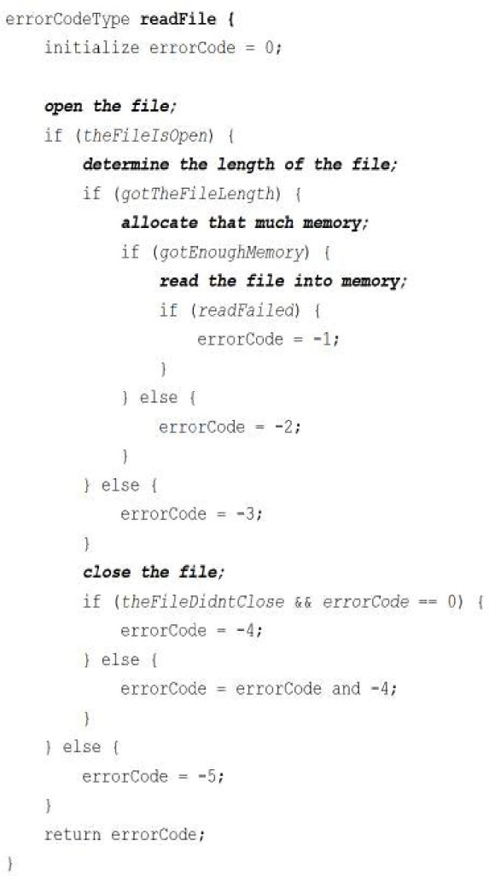
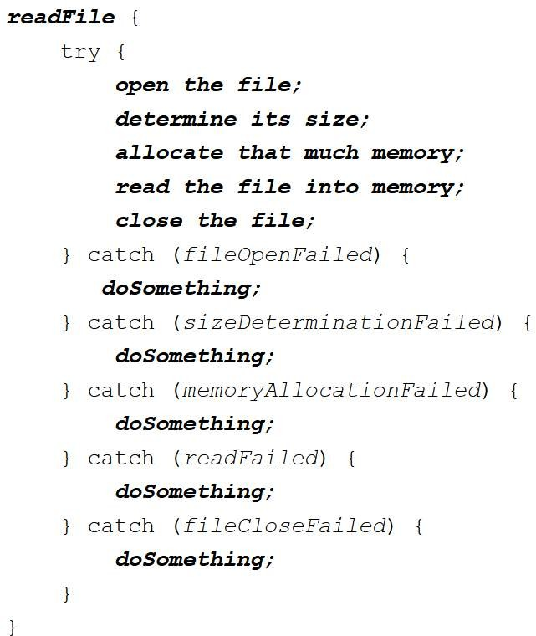
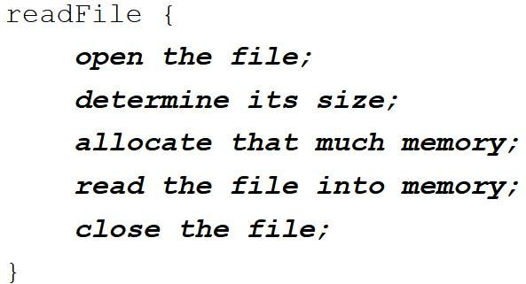
Exceptions
Consider building a centralized exception reporter
Exceptions provide the means to separate the details of what to do when something out of the ordinary. Error detection, reporting, and handling often lead to confusing spaghetti code

Slide 12
Determining How Much Defensive Programming to Leave in Production Code
Leave in code that checks for important errors
Leave in code that helps the program crash gracefully
Log errors for your technical support personnel
Make sure that error messages you leave in are friendly

Slide 13
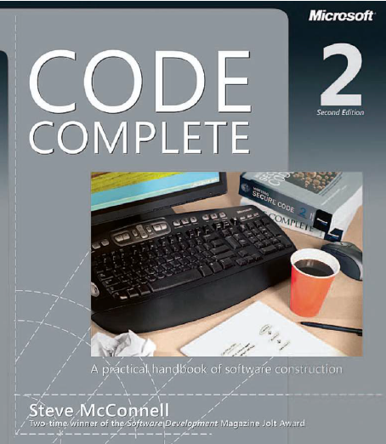
Reading
Code Complete: A Practical Handbook of Software Construction, 2nd Edition, Steve McConnell.
Chapter 8

Slide 14

Any questions? ​
Please feel free to raise your hands and ask.

